Slide 1
Introduction to hashing python
Understanding Data Integrity and Security
Saif Abusnaneh

Slide 2
What is hashing ???
Hash is process convert any data to fixed sequence of letters and numbers
Has is one-way : cant return hash to plaintext
Deterministic : same input same hash
Fixed length : length of hash fixed
Avalanche effect : any simple change input change all hash

Slide 3
Why do we use Hashing ??
Password storage: Passwords are not stored as is; instead, their hashes are stored.
Data integrity: Ensuring that the file has not been tampered with during upload.
Digital signature: Verifying the sender's identity.

Slide 4
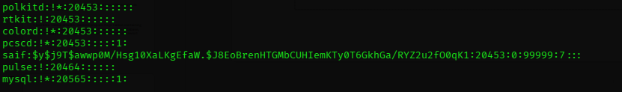
How linux save password ??

Slide 5
The Mechanism
Hashing is not just a "shuffling" of letters; it involves complex mathematical operations:
Padding : The algorithm adds extra bits to the inputs in order to reach a certain fixed length.
Compression Function: The data is divided into blocks, and each block goes into a mathematical "mill" (Logical operations such as: XOR, AND, OR, Shift).
Iterative Process: The result from the first block is combined with the block after it, and so on until the final result (called Digest) is obtained.

Slide 6
Advanced Concepts
A collision is a very rare occurrence where two different inputs receive the same hash.
Rainbow Tables attacks: Hackers prepare huge tables containing popular passwords and their hashes. If they steal the database, they simply perform a "comparison" and recover the password.

Slide 7
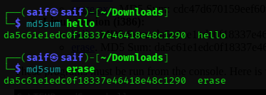
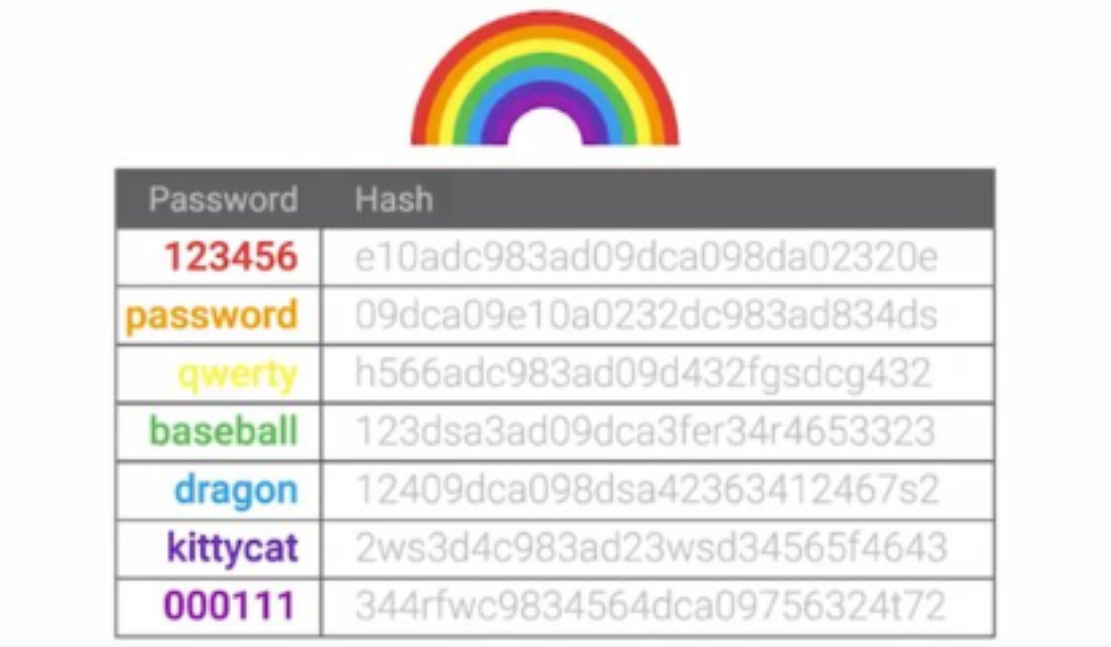
MD5 collision & Rainbow Tables attacks
Collision :
Rainbow Tables :

Slide 8
Hashing VS Encryption
Feature | Hashing | Encryption
Direction | One-way | Two-way
Primaty Goal | Integrity | Confidentiality
Key Required? | No | Yes(public/private or symmetric)

